Slide 1
Security management
Course Instructor: Dr. Zainab Abaid

Slide 2
Management processes
Management is more important than technology – true or false?
Security is a process, not a product (Bruce Schneier)
2

Slide 3
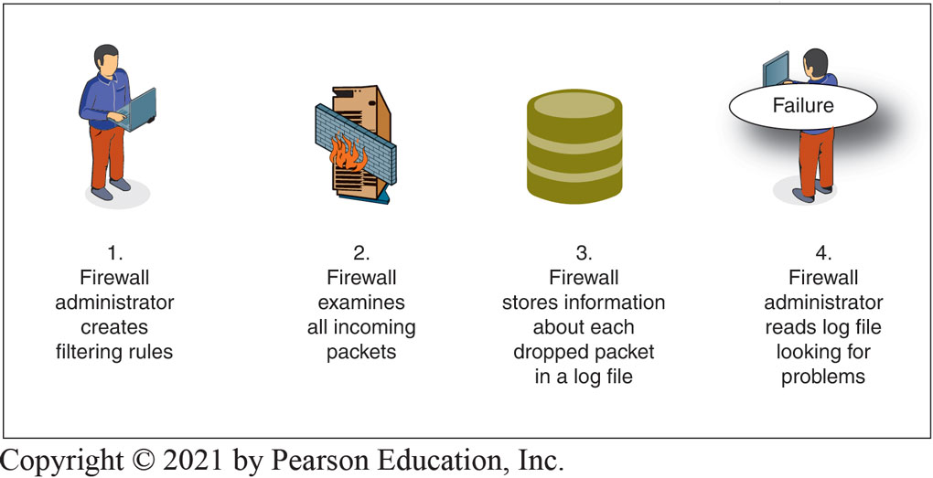
Why is management hard?
Need to protect many resources comprehensively, where a single component could lead to failure.
3
Notes:
multiple elements needs to work in tandem for the security to be effective
If the failure of a single element of a system will ruin security, this is a weakest-link failure.

Slide 4
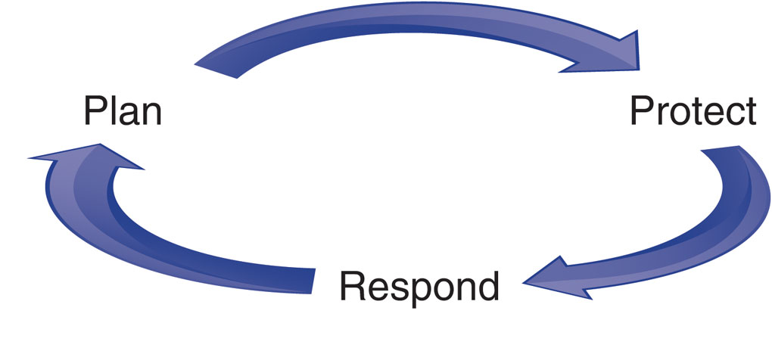
Overall Strategy
Notes:
If security processes must be managed comprehensively, we need a formal top-level security management process. Most firms today protect against threats by using a highest-level security management process called the plan–protect–respond cycle.
PLANNING The cycle begins with planning. Without an excellent plan, you will never have comprehensive security.
PROTECTION Protection is the plan-based creation and operation of countermeasures.
RESPONSE Even with great planning and meticulous protection, some attacks will succeed.
Our course also follows this cycle.

Slide 5
Where to place security?
Within IT
Outside IT
Hybrid
Outsource IT Security
5
Notes:
Should You Place Security within IT?
Within IT
Compatible technical skills
CIO will be responsible for security
Outside IT
Gives independence
Hard to blow the whistle on IT and the CIO
This is the most commonly advised choice
Hybrid
Place planning, policy making, and auditing outside of IT
Place operational aspects such as firewall operation within IT
Outsourcing IT Security
Only e-mail or webservice
Managed Security Service Providers (MSSPs)
Outsource most IT security functions to the MSSP
But usually not policy

Slide 6
Some terminology
Asset is an item of value
Vulnerability is a flaw that weakens the security of the system
Exploit is the action of taking advantage of the vulnerability
Threat is a possible danger that may exploit a vulnerability
Threat Agent is the entity that carries out the threat
Attack/Breach/Compromise evades security services or violates system security policy.
6
Notes:
Should You Place Security within IT?
Within IT
Compatible technical skills
CIO will be responsible for security
Outside IT
Gives independence
Hard to blow the whistle on IT and the CIO
This is the most commonly advised choice
Hybrid
Place planning, policy making, and auditing outside of IT
Place operational aspects such as firewall operation within IT
Outsourcing IT Security
Only e-mail or webservice
Managed Security Service Providers (MSSPs)
Outsource most IT security functions to the MSSP
But usually not policy

Slide 7
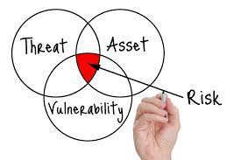
SOME TERMINOLOGY
Risk is an expectation of loss
Countermeasures/Mitigation: an action, procedure or technical intervention that reduces risk
7
Notes:
risk is the potential for loss, damage or destruction of assets or data caused by a cyber threat

Slide 8
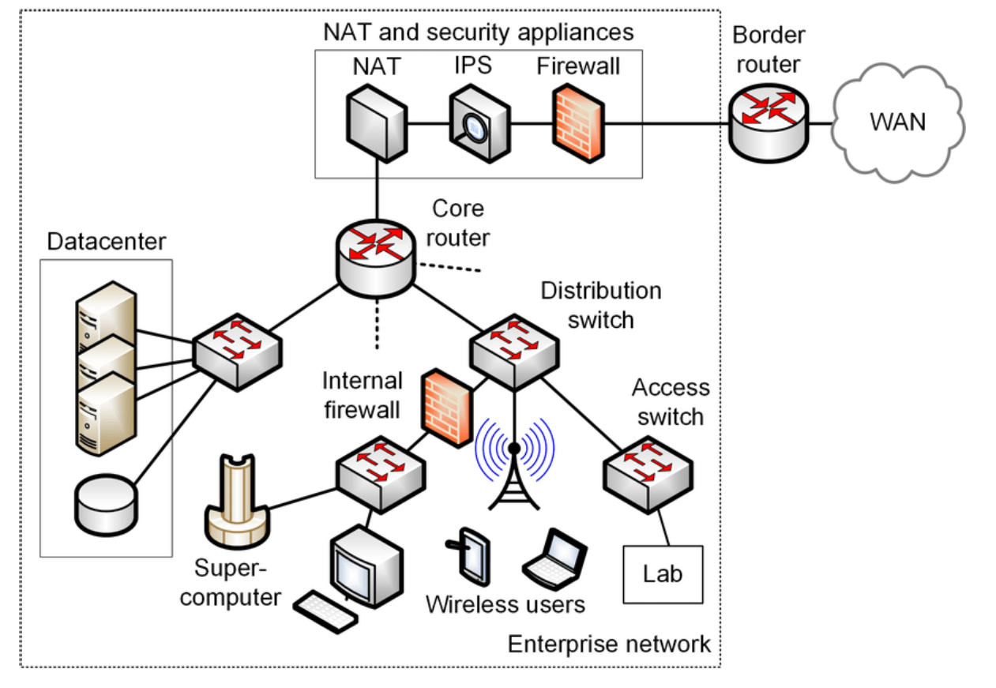
An example enterprise network is given above. The firewalls are misconfigured, authentication mechanisms are weak, the wireless access point is using a 40-bit key, the database is not encrypted. Identify 3 assets along with vulnerability, threat, risk, and countermeasure.
Assets | Vulnerability | Threat | Risk | Countermeasure
Notes:
Information Security Terminology
Table 1-4 Information technology assets

Slide 9
risk analysis
Can never eliminate risk
True “information assurance” is impossible
Goal is reasonable risk
Risk analysis weighs the probable cost of compromises against the costs of countermeasures
Notes:
Realities
Can never eliminate risk; the goal is to manage risks
“Information assurance” is impossible
Risk Analysis
Goal is reasonable risk
Risk analysis weighs the probable cost of compromises against the costs of countermeasures
Also, security has negative side effects that must be weighed
Need to think in terms of “reasonable risk”
It makes no sense to pay a million dollars to guard a $2,000 laptop that contains no sensitive information.

Slide 10

Reasonable Risk
If you live in a quiet and safe neighborhood, putting bars on your windows would create an unpleasant locked-down feeling.
Requiring you to remember a long password to get into your house would slow you down every time you enter your house.

Slide 11
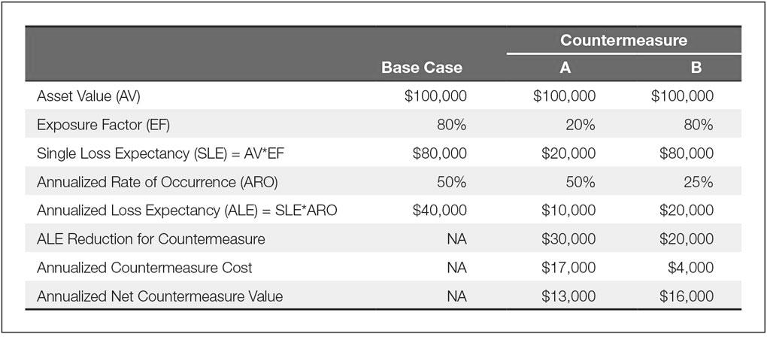
CLASSIC RISK ANALYSIS
Notes:
Some IT security certification exams test a simple process for (1) computing probable losses, (2) computing how countermeasures will alter the likelihood of losses, and (3) deciding whether those countermeasures produce benefits that exceed their costs. This is the classic risk analysis calculation and is illustrated in this figure.
EXAMPLES: FIRE, FAILURE, THEFT, VIRUS

Slide 12
Risk analysis activity: problem 1
A building is valued at $100,000. A fire would damage 25% of the building. Insurance underwriting suggests fires occur once every ten years. How much should be spent on fire suppression annually?

Slide 13
Problem 1 Solution
AV= $ 100,000
SLE= AV x EF = $100,000 x 25% = $25000
ALE= SLE x ARO = $25,000 x 0.1 = $2,500
Therefore, spend $2500 on fire suppression? Not exactly, because the SLE is unrealistic (does not account for possible loss of life, relative value of different parts of the building, down time)

Slide 14
Risk analysis activity: problem 2
Let’s say that your organization is considering some solution that can help you to discover malicious insider actions on your file servers to reduce the risk of losing a particular piece of intellectual property (IP). The IP asset of interest has a value of $75,000. If leaked, the asset will only retain 25% of its value. There’s a 90% chance of malicious insider activity occurring in any given year).
The software solution has a license fee of $10,000 and decreases the chance of malicious insider activity to 55%.
Filing a patent for IP protection cost $25,000 but reduces the chance of malicious insider activity to 35%
Which countermeasure is better and by how much?

Slide 15
Problem 2 Solution
 | Base Case | License Fee | Patent
Asset value (AV) | $75, 000 | $75, 000 | $75, 000
Exposure Factor (EF) | 75% | 75% | 75%
Single Loss Expectancy (SLE) = AV x EF | $75,000 x .75 =$ 56,250 | $75,000 x .75 =$ 56,250 | $75,000 x .75 =$ 56,250
Annualized Rate of Occurrence (ARO) | 90% | 55% | 35%
Annualized Loss Expectancy (ALE) = ARO x SLE | 0.90 x $ 56,250 =$50,625 | 0.55 x 56,250 =$30938 | 0.35 x 56,250 =$19688
ALE Reduction for countermeasure | - | $19687 | $30937
Annualized Countermeasure Cost | - | $10000 | $25000
Annualized Net Countermeasure Value | - | $9687 | $5937

Slide 16
Risk analysis activity: problem 3
You are the administrator of a web server for Amazon that generates 25,000 per hour in revenue. The probability of the failure during the year is estimated to be 25 percent. A failure would lead to three hours of down time and cost $ 5,000 in components to correct.
What is the ALE?
Should you be willing to spend $ 100,000 on a backup server with same metrics?

Slide 17
Problem 3 Solution
 | Base Case | Countermeasure 1 | Countermeasure 2
Asset value (AV)
Exposure Factor (EF)
Single Loss Expectancy (SLE) = AV x EF | $80,000 | $ 80,000
Annualized Rate of Occurrence (ARO) | 0.25 | 0.0625
Annualized Loss Expectancy (ALE) = ARO x SLE | $80,000 x 0.25 =$ 20,000 | $80,000 x 0.0625 =$5,000
ALE Reduction for countermeasure | - | $20,000-$5000= $15000
Annualized Countermeasure Cost | - | $100,000
Annualized Net Countermeasure Value | - | -$85,000

Slide 18
LIMITATIONS OF RISK ANALYSIS
Uneven multiyear cashflows
Total Cost of Incident
Many-to-Many Relationship between countermeasures and resources
Notes:
Uneven Multiyear Cash Flows
For both attack costs and defense costs
Total Cost of Incident (TCI)
Exposure factor in classic risk analysis assumes that a percentage of the asset is lost
In most cases, damage does not come from asset loss
Many-to-Many Relationships between Countermeasures and Resources
A single countermeasure can protect many assets and a single asset can be protected by many different countermeasures
Impossibility of Knowing the Annualized Rate of Occurrence
Simply no way to estimate this
As a consequence, firms too often merely rate their resources by risk level
Problems with “Hard-Headed Thinking”
Security benefits are difficult to quantify; may underinvest
Perspective
Impossible to do perfectly; must be done as well as possible

Slide 19
LIMITATIONS OF RISK ANALYSIS
Impossibility of Knowing the Annualized Rate of Occurrence
Problems with “Hard-Headed Thinking”
Perspective
Notes:
Impossibility of Knowing the Annualized Rate of Occurrence
Simply no way to estimate this
Problems with “Hard-Headed Thinking”
Security benefits are difficult to quantify; may underinvest
Perspective
Impossible to do perfectly; must be done as well as possible

Slide 20
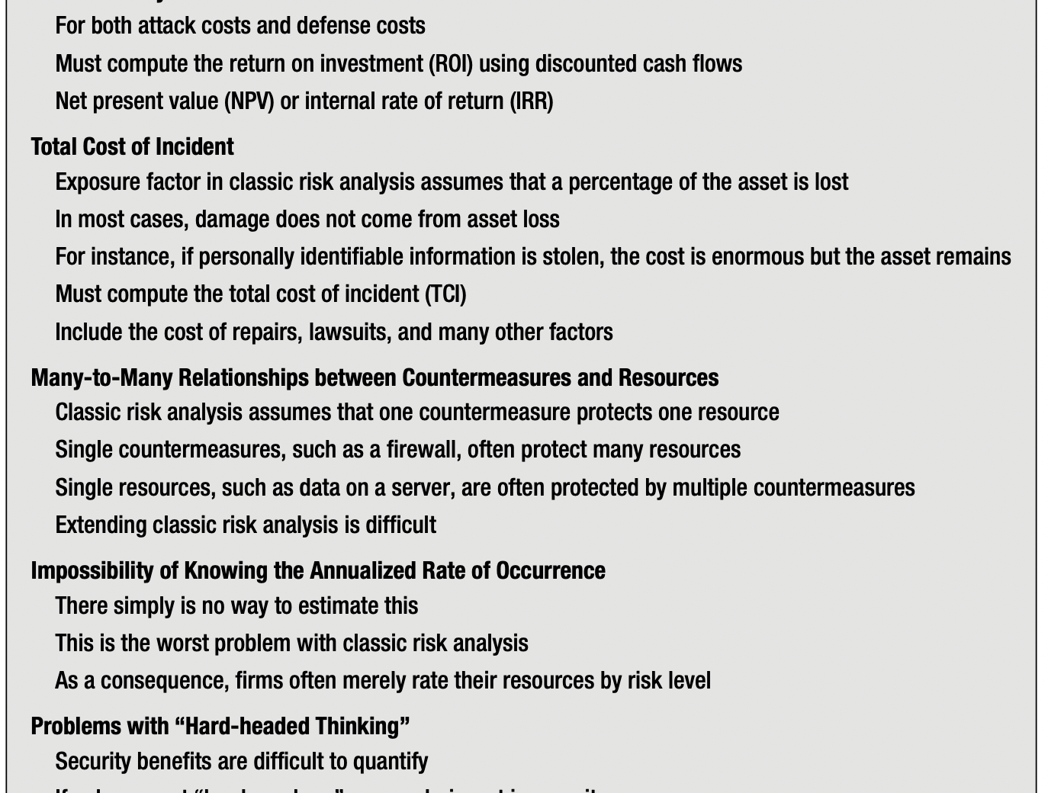
Risk Analysis Limitations (summary)

